Slide 1
Developing STEM skills and numeracy with LogiQ Board
This material is protected by copyright. All rights reserved. Please contact LearningChess for permission to copy or distribute.
Mark Szavin
LearningChess
London Chess Conference 2019
This material is protected by copyright. All rights reserved. Please contact LearningChess for permission to copy or distribute.

Slide 2
STEM Skills
-Analytical thinking
-Planning
-Spatial skills
-Creativity vs. Schemas
-Numeracy
Problem-solving
Copyright © LearningChess 2019

Slide 3
Problem solving
Copyright © LearningChess 2019

Slide 4
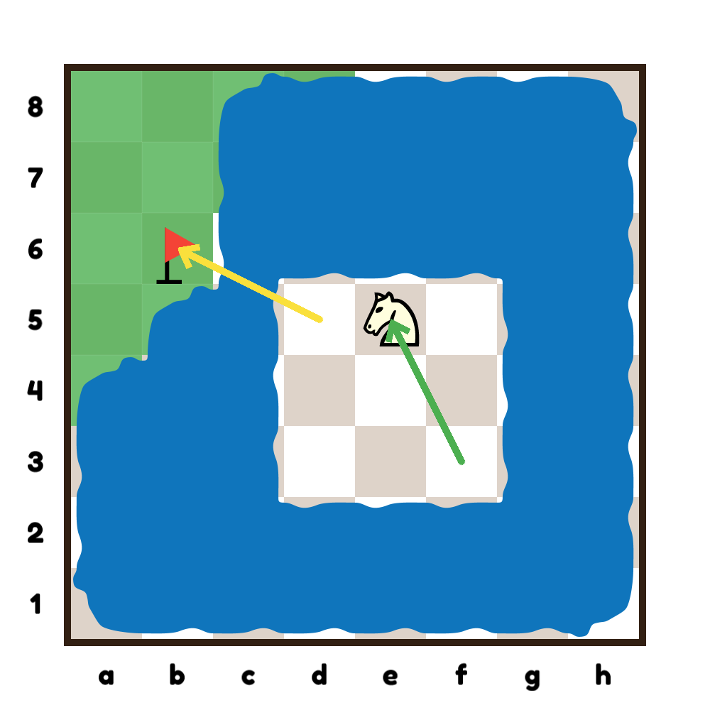
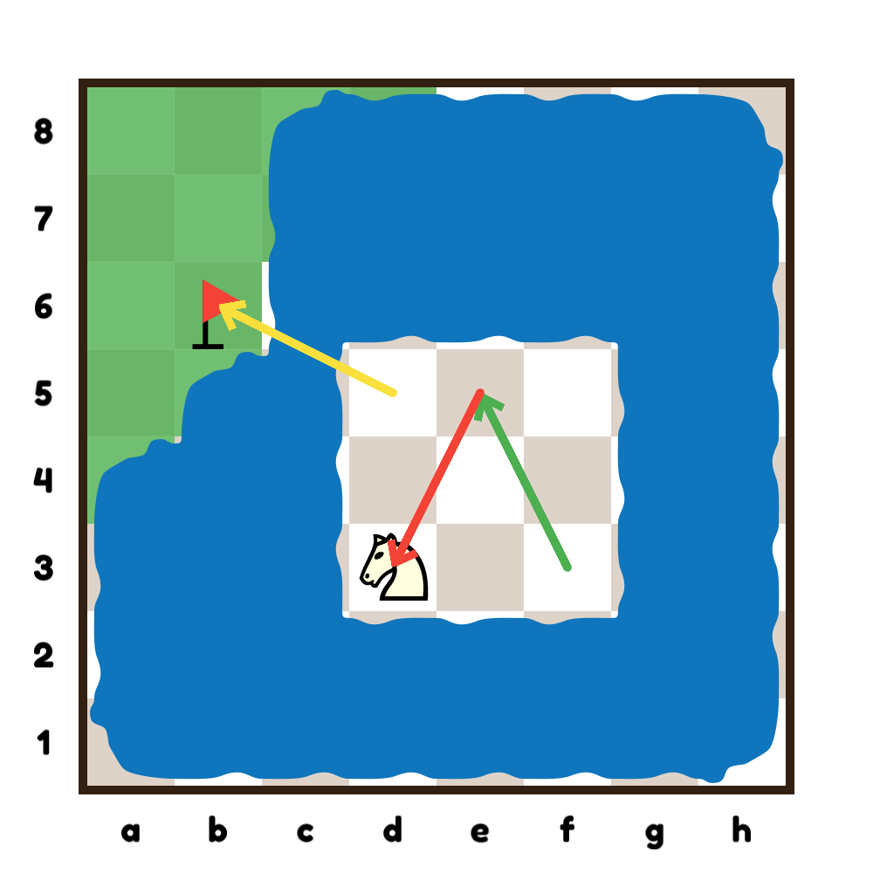
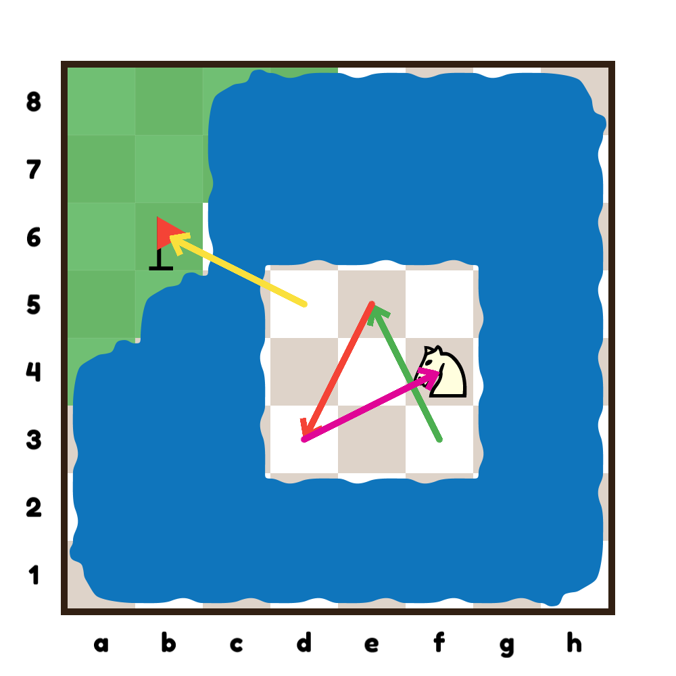
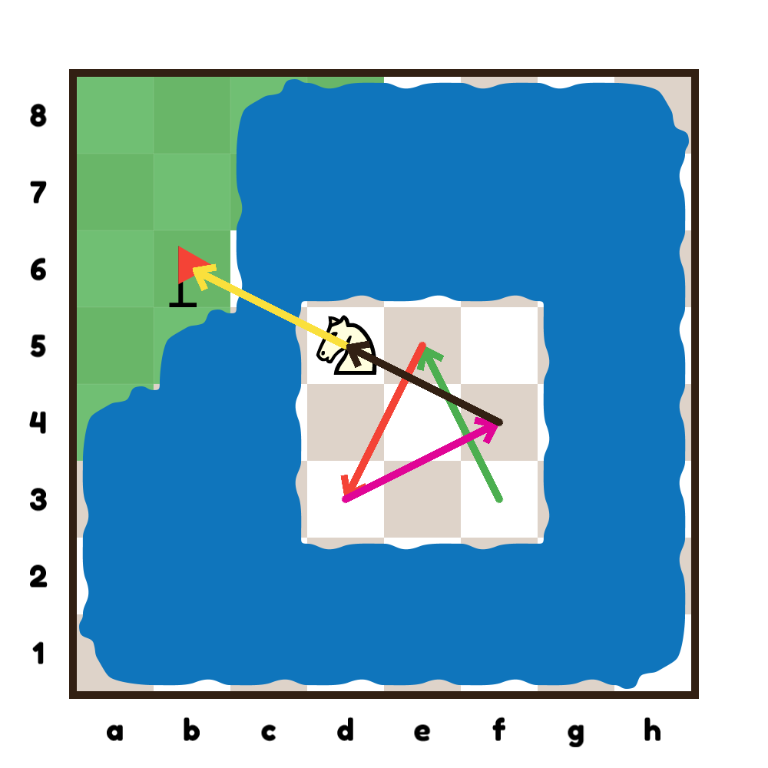
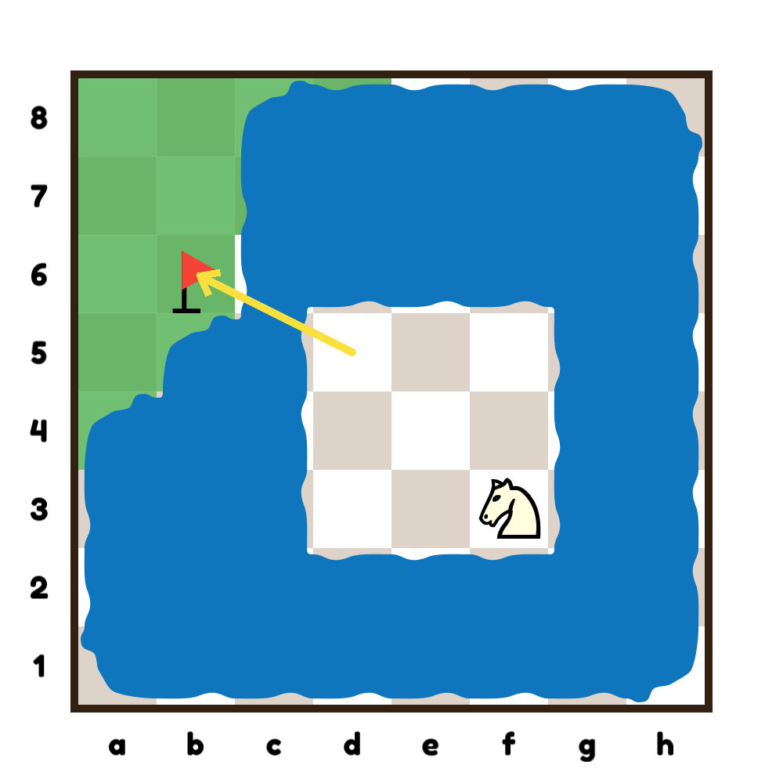
Strategies
Divide
Experiment
Reduce
Restate
Copyright © LearningChess 2019

Slide 5
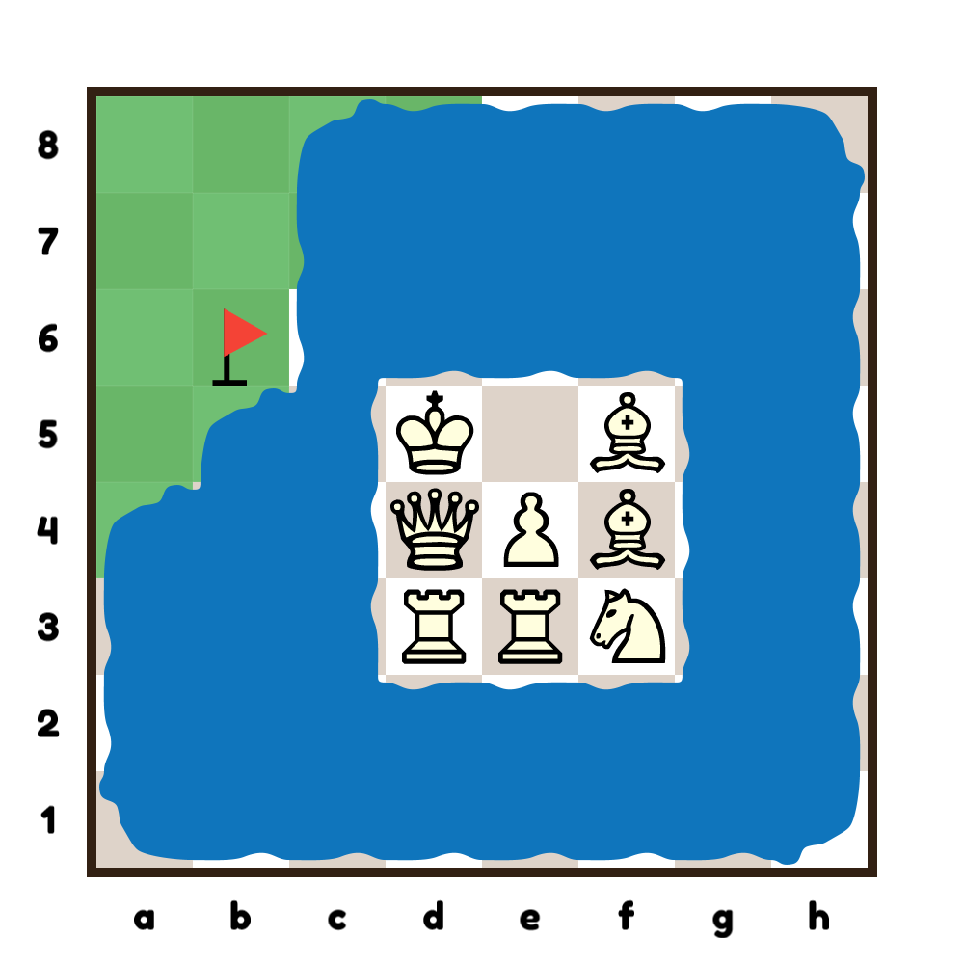
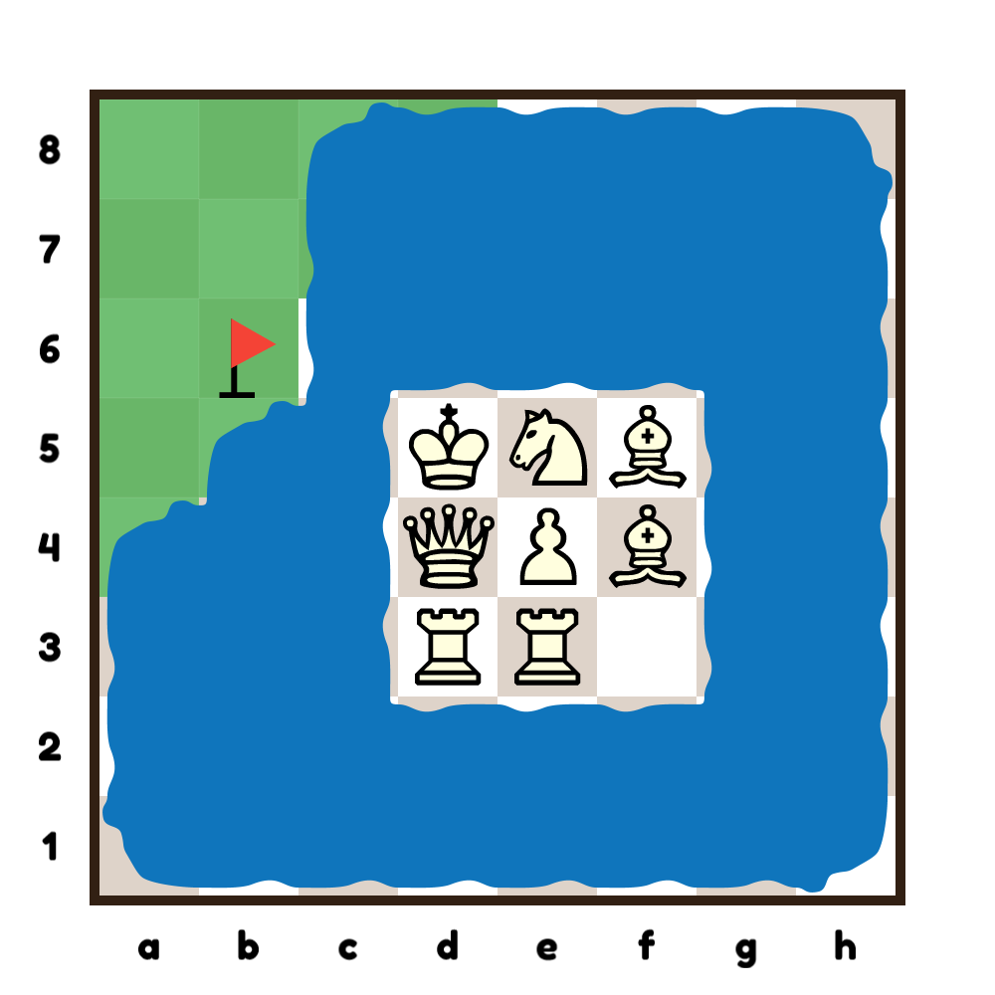
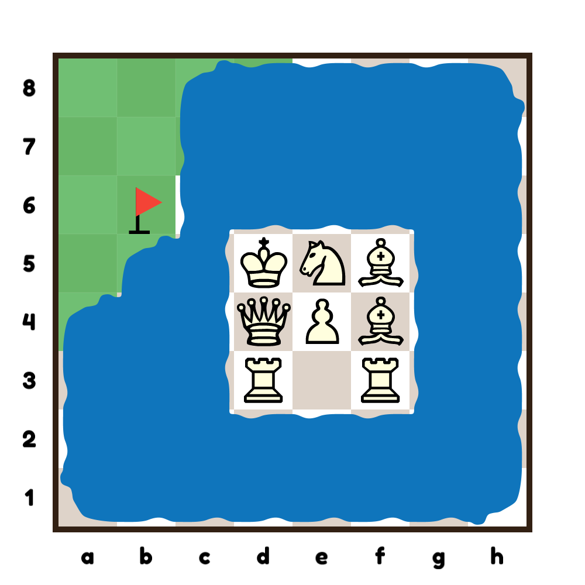
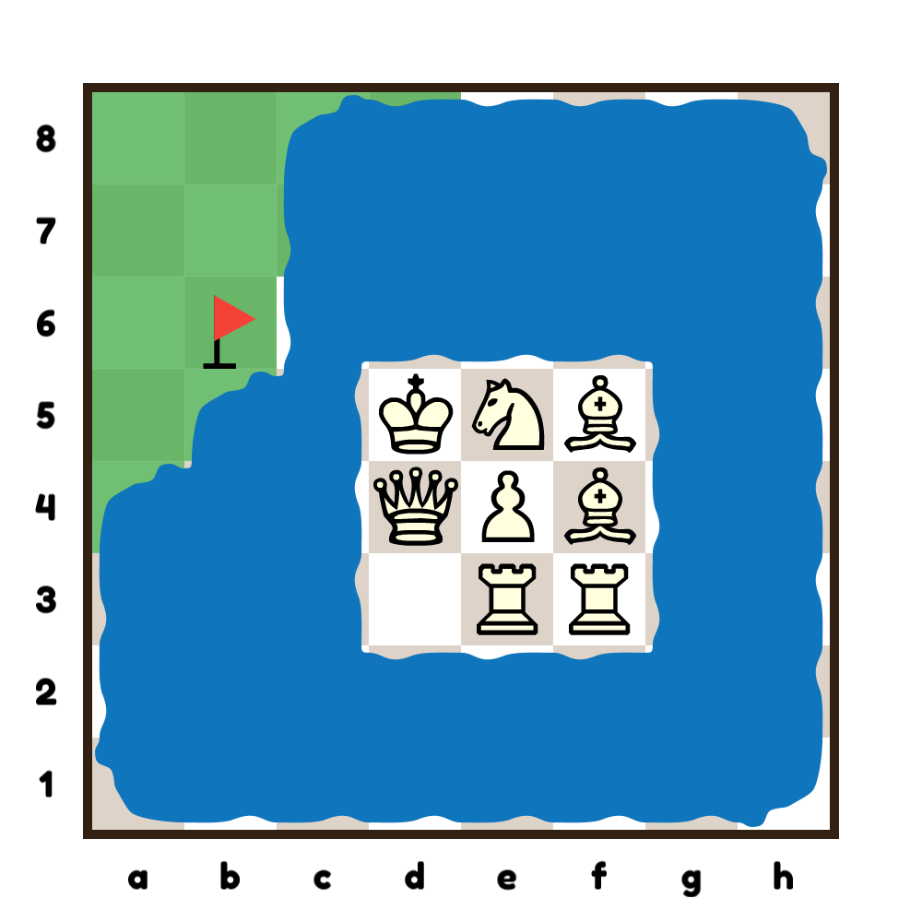
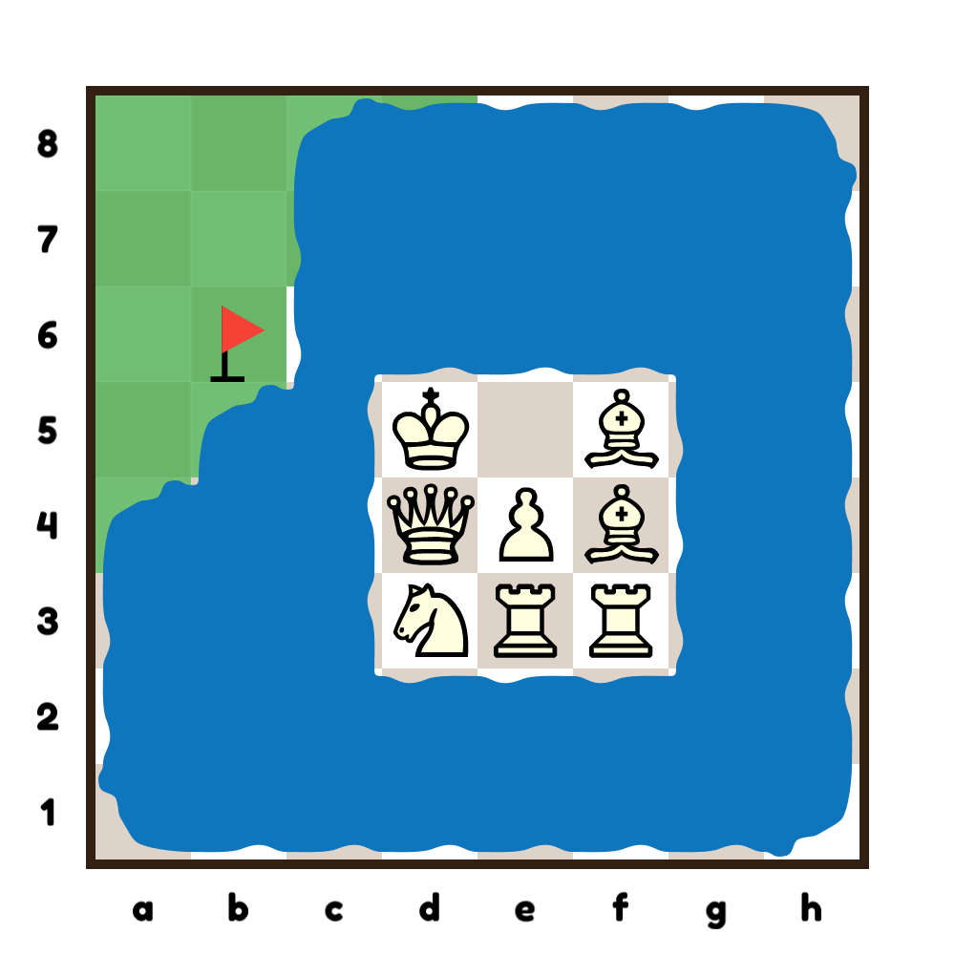
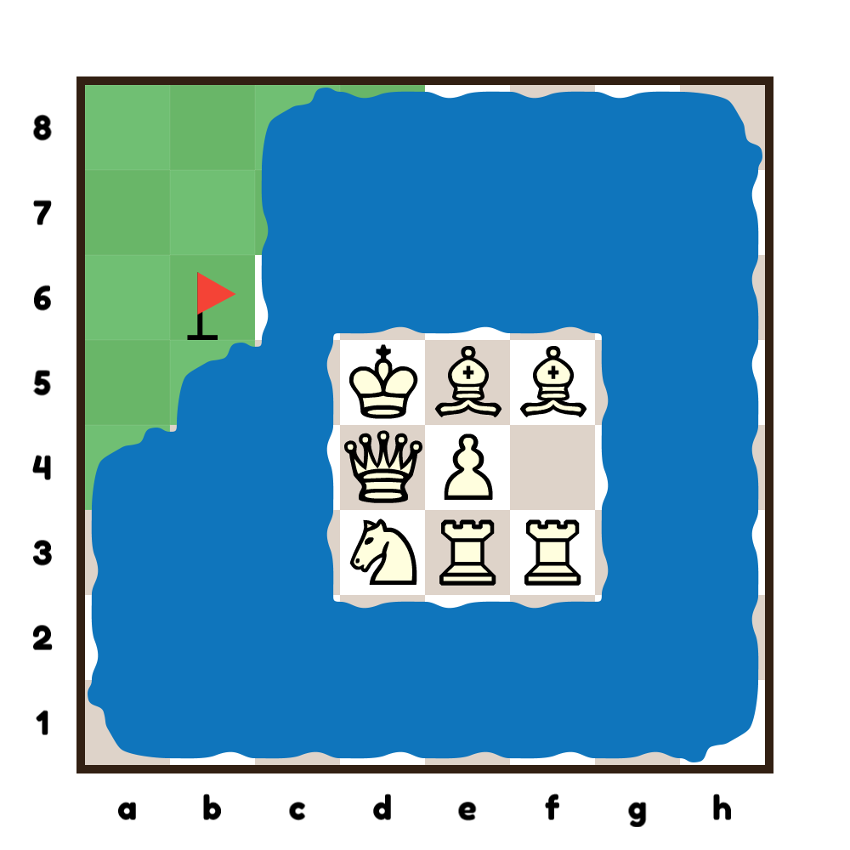
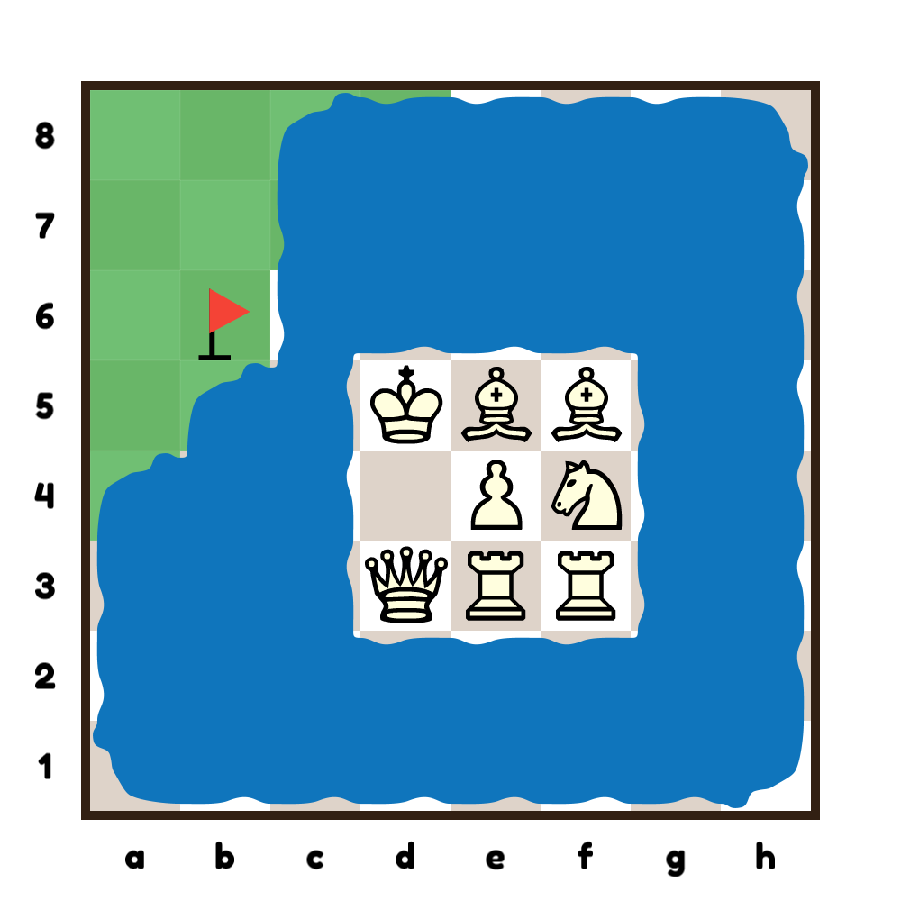
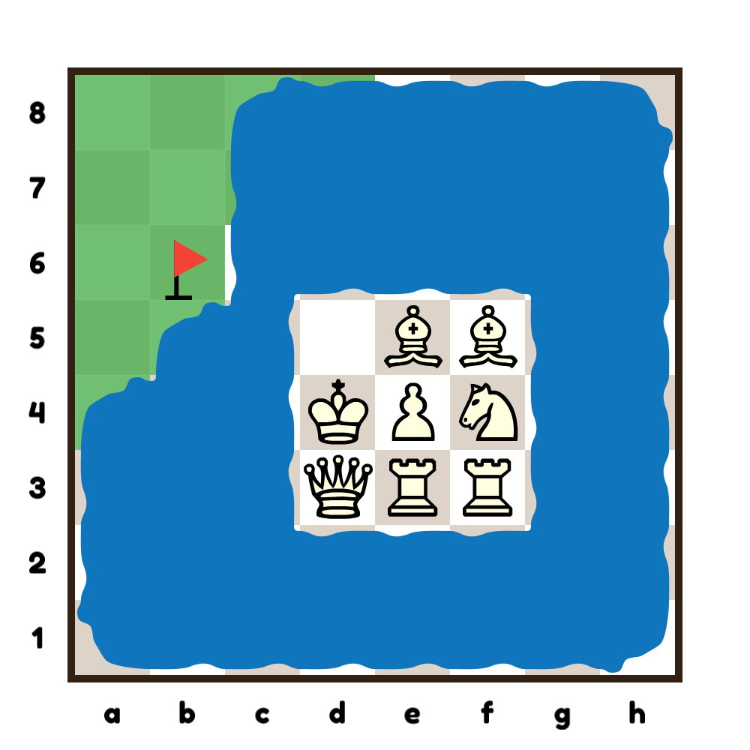
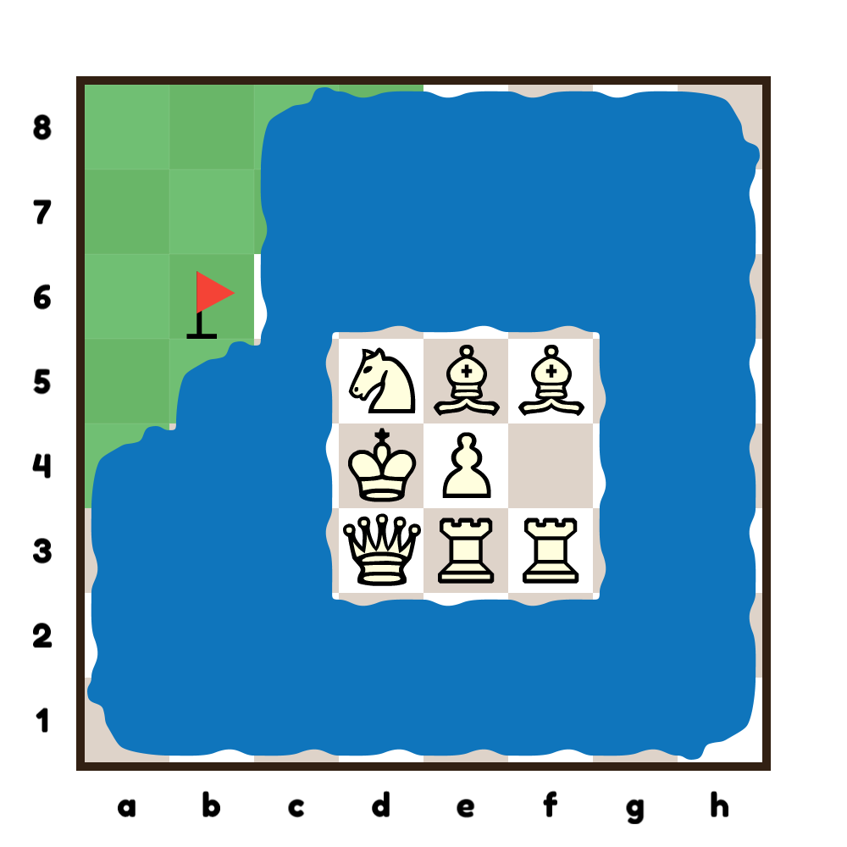
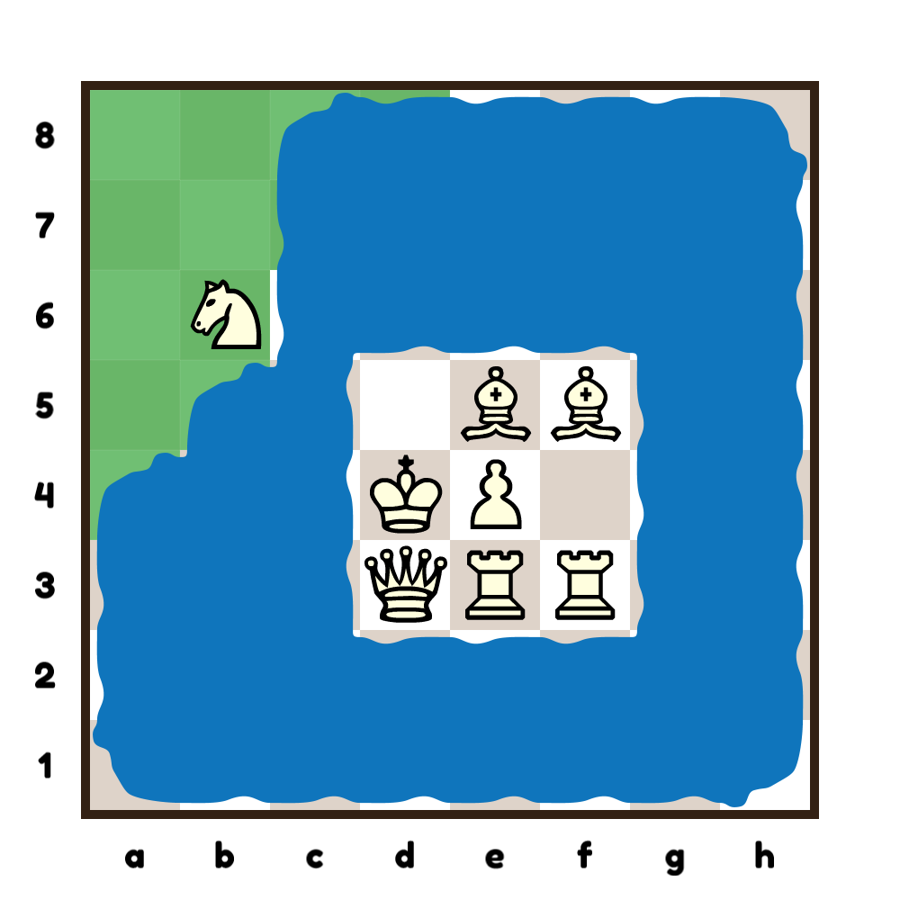
Solution
Copyright © LearningChess 2019

Slide 6
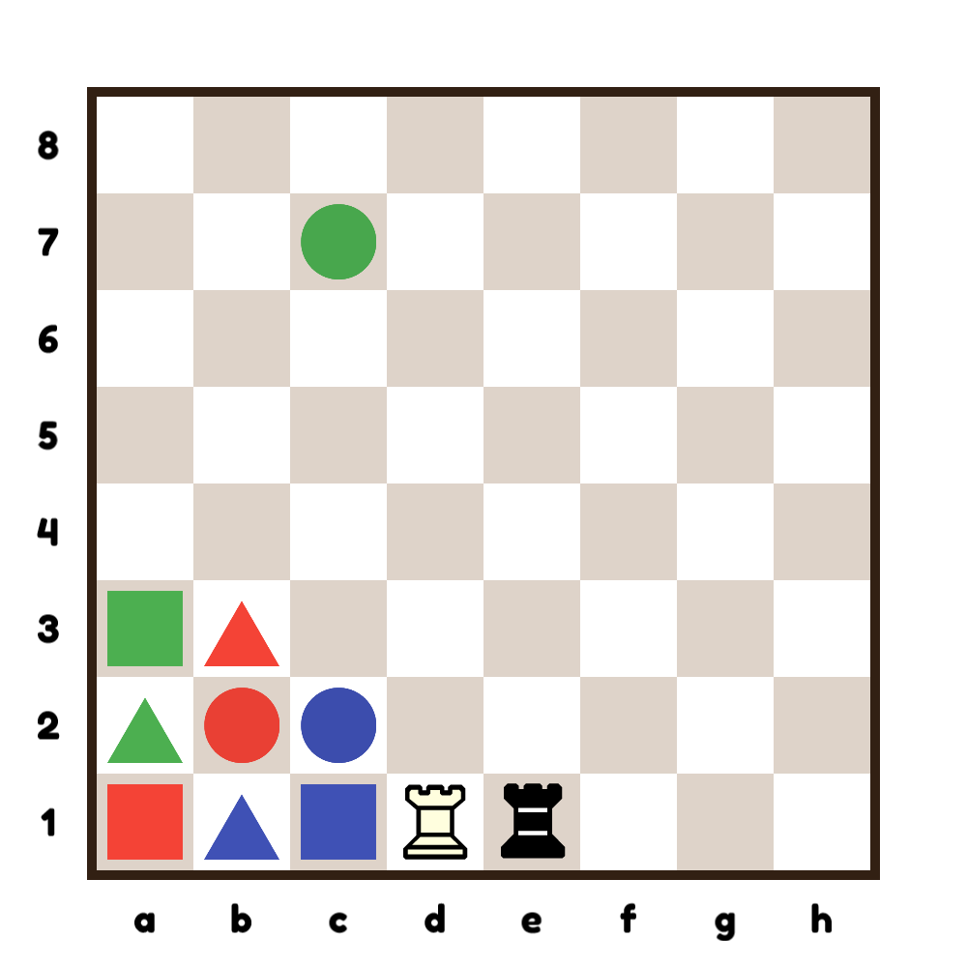
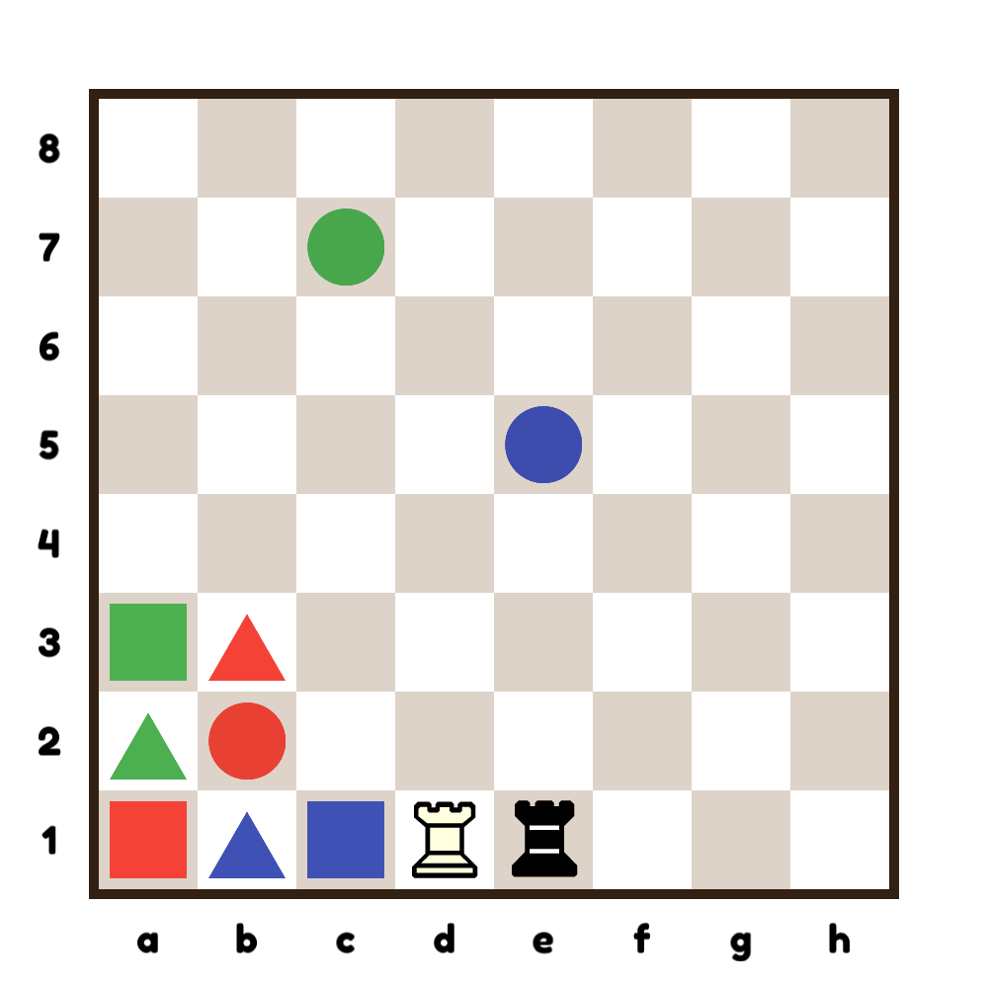
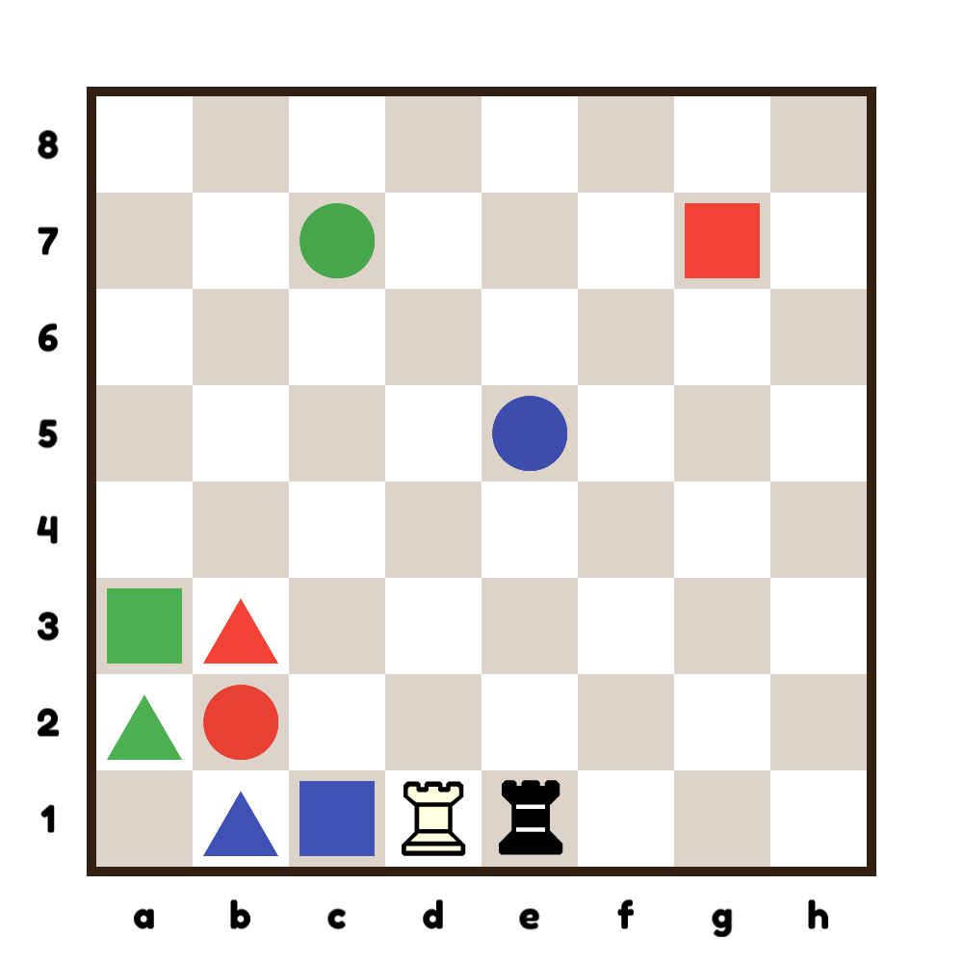
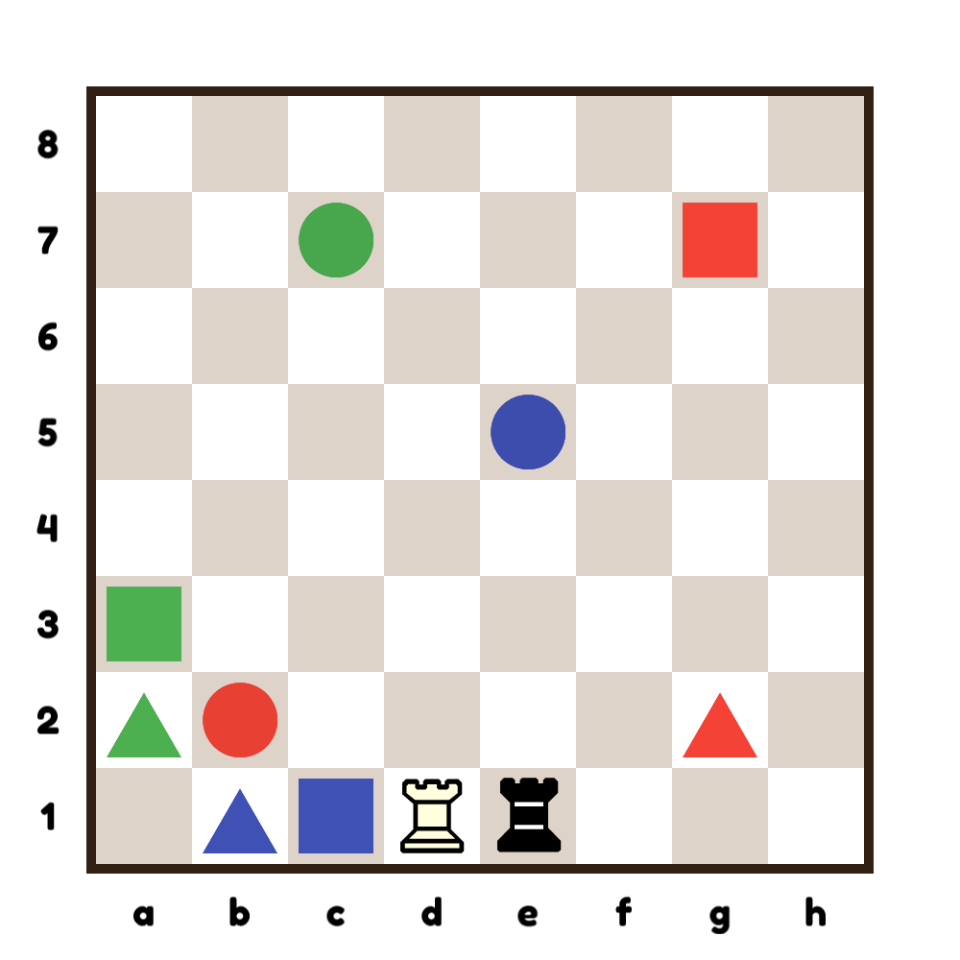
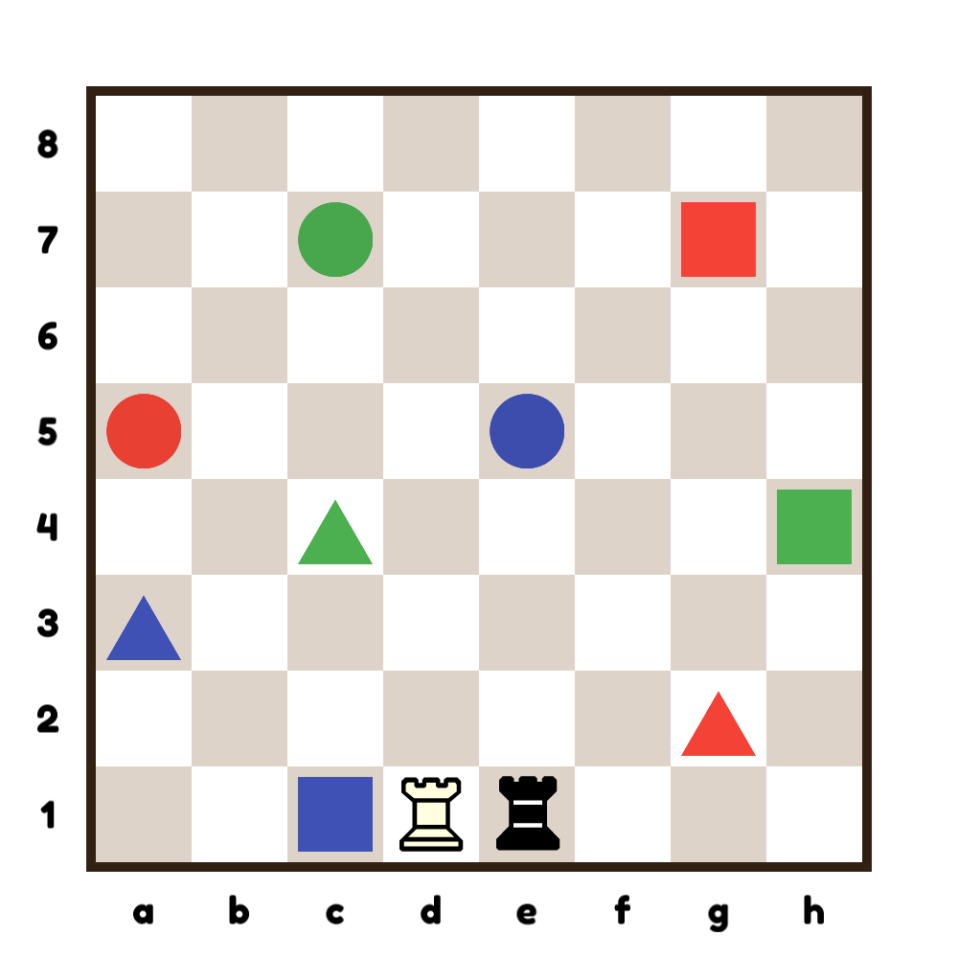
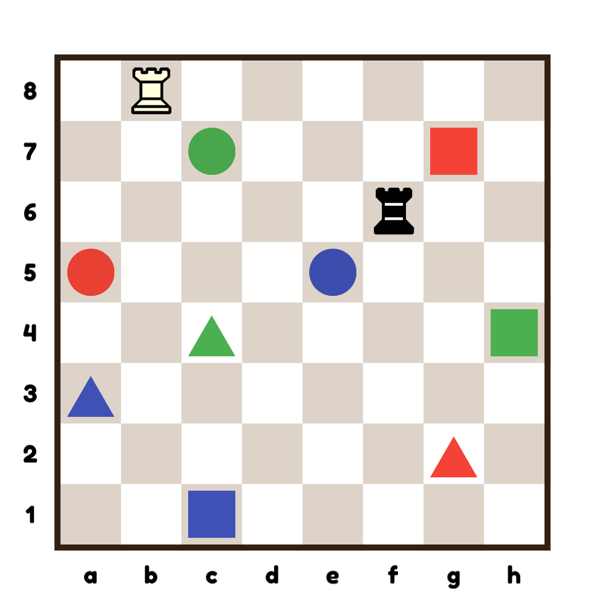
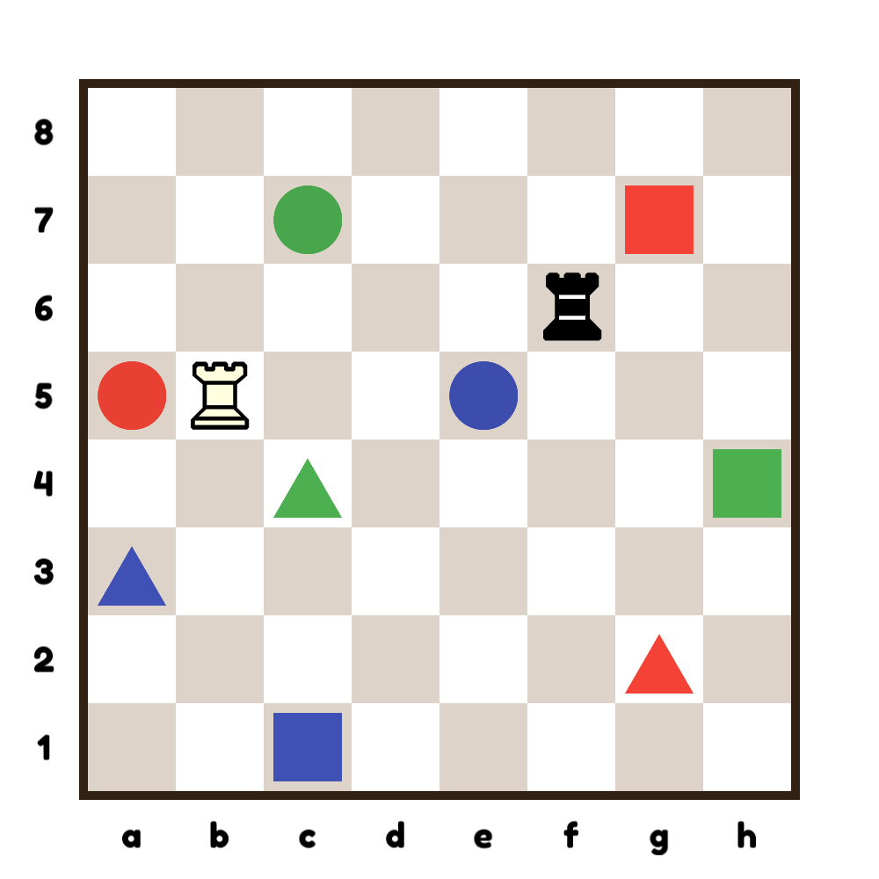
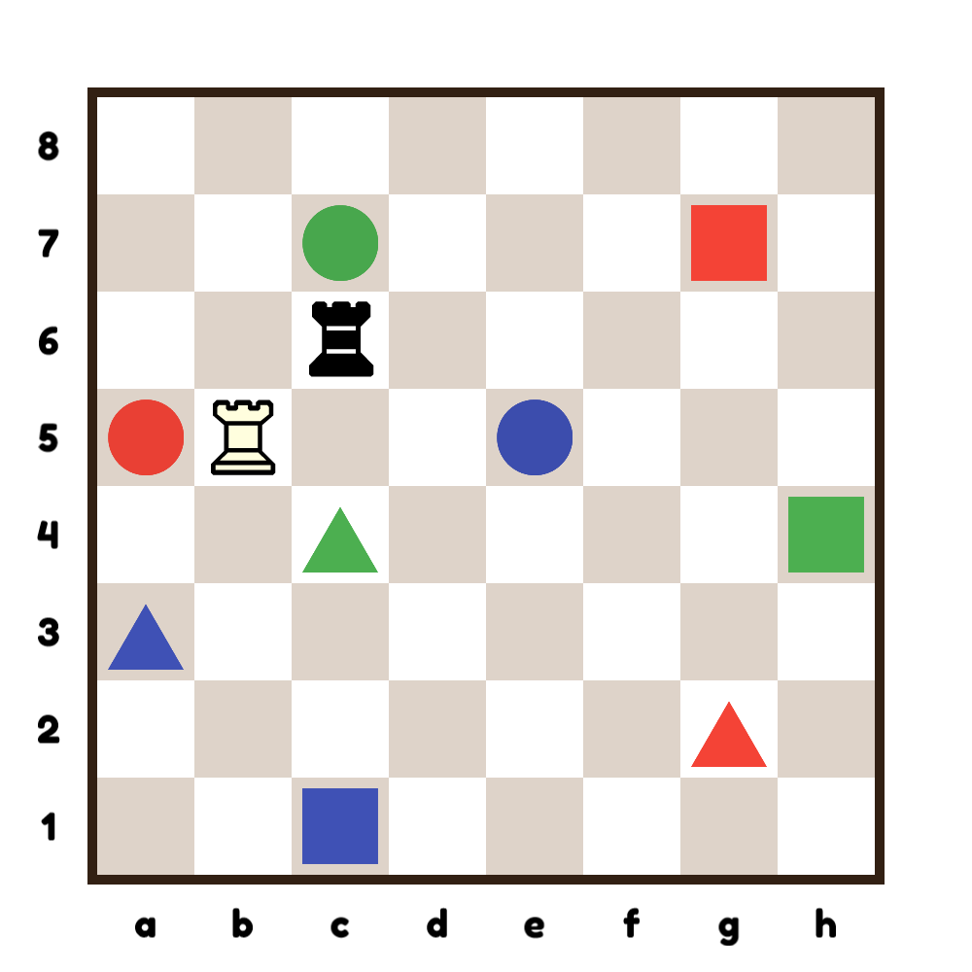
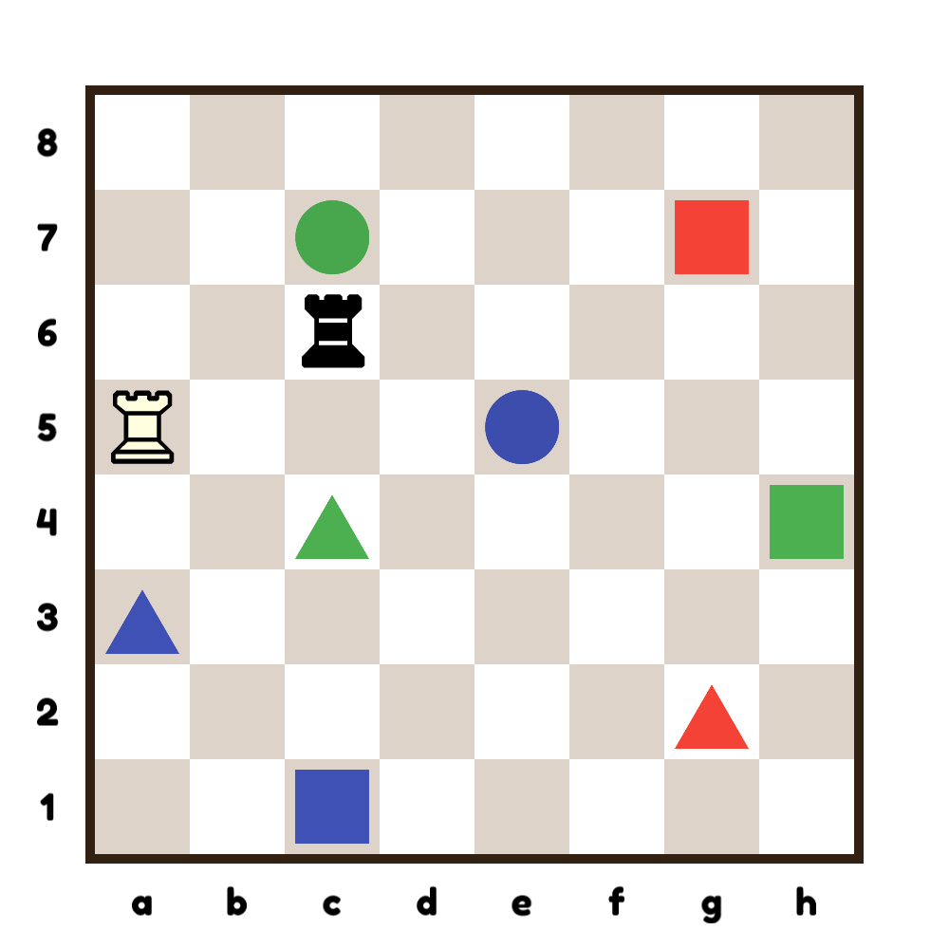
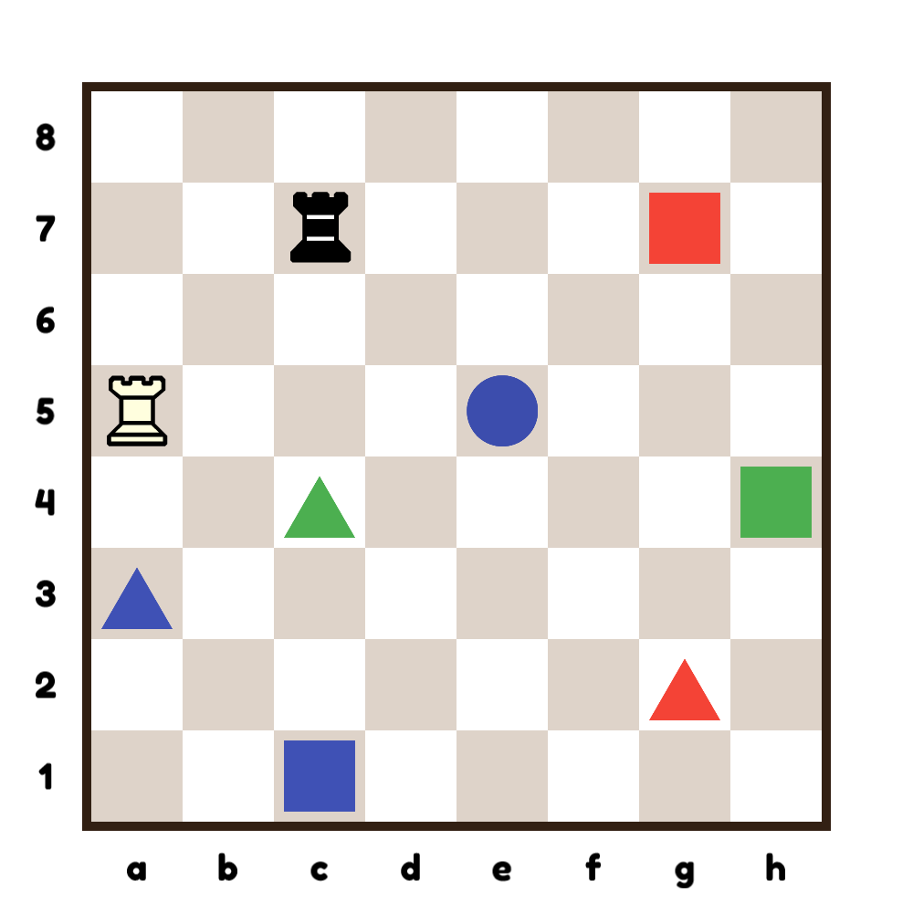
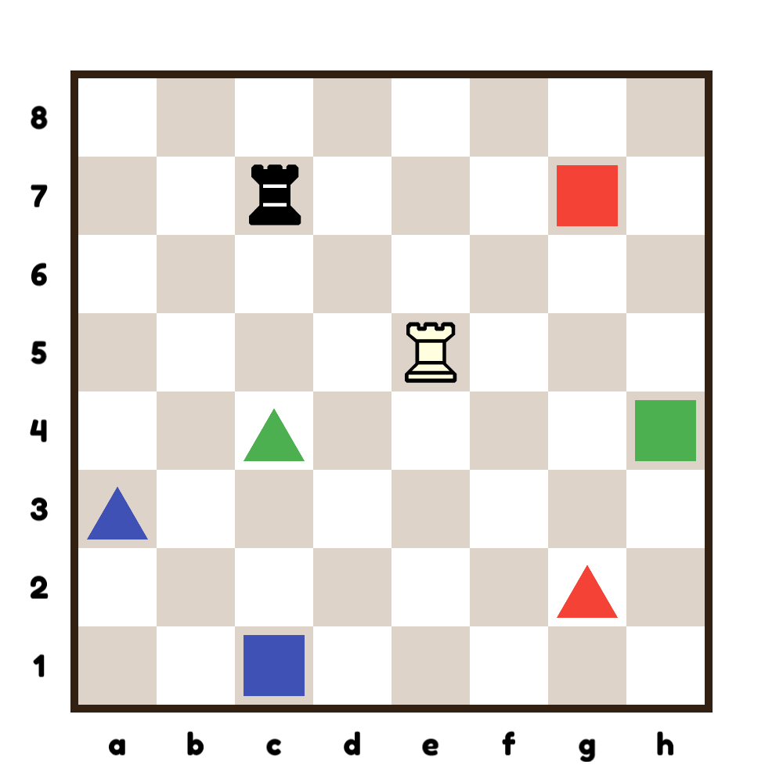
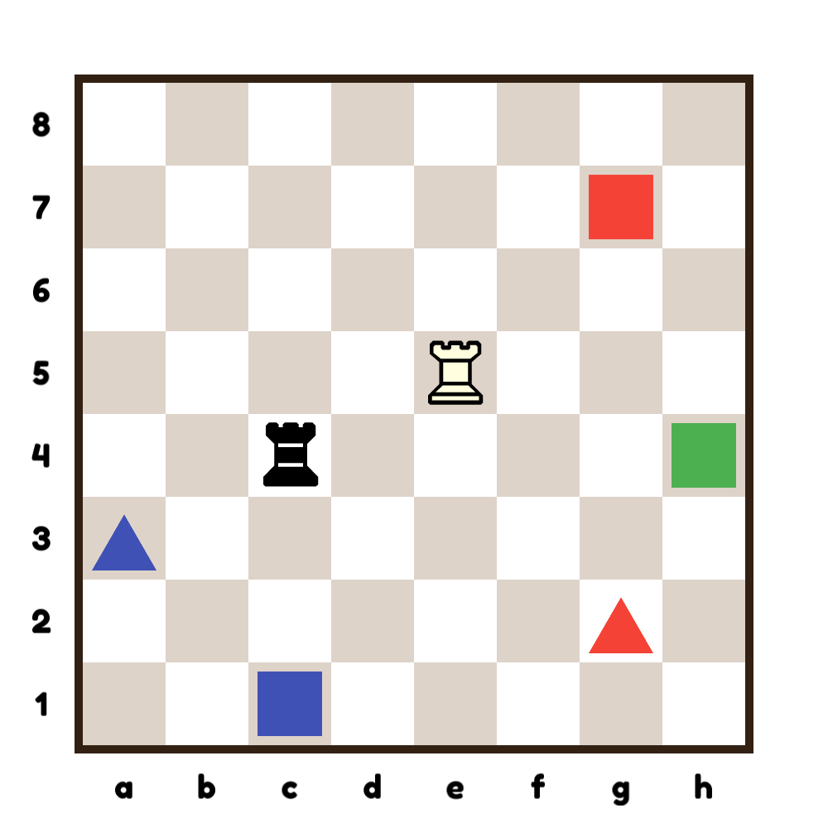
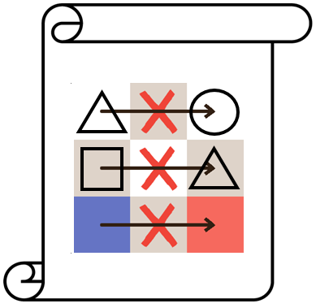
Simple algorithms
following the rules
Planning
Sustained mental focus
Copyright © LearningChess 2019

Slide 7
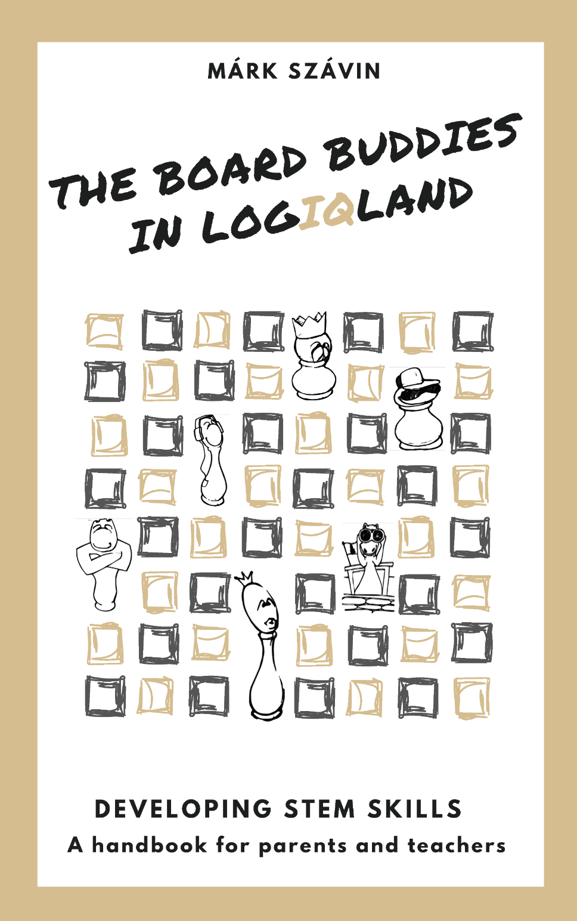
Board Buddies in LogiQ Land
A collection for teachers and parents
9 games
25 puzzles
Instructions
Hints for practical use
Tested in practice
+ 100s of variants
Copyright © LearningChess 2019

Slide 8
Board Buddies in LogiQ Land
5 areas of STEM skill development:
Problem Solving – applying strategies
Spatial Skills – mental rotation, visualizing
Logic – patterns and grouping
Mathematics – relations, numeracy
Simple Algorithms – iteration, sequences, sorting
Copyright © LearningChess 2019

Slide 9
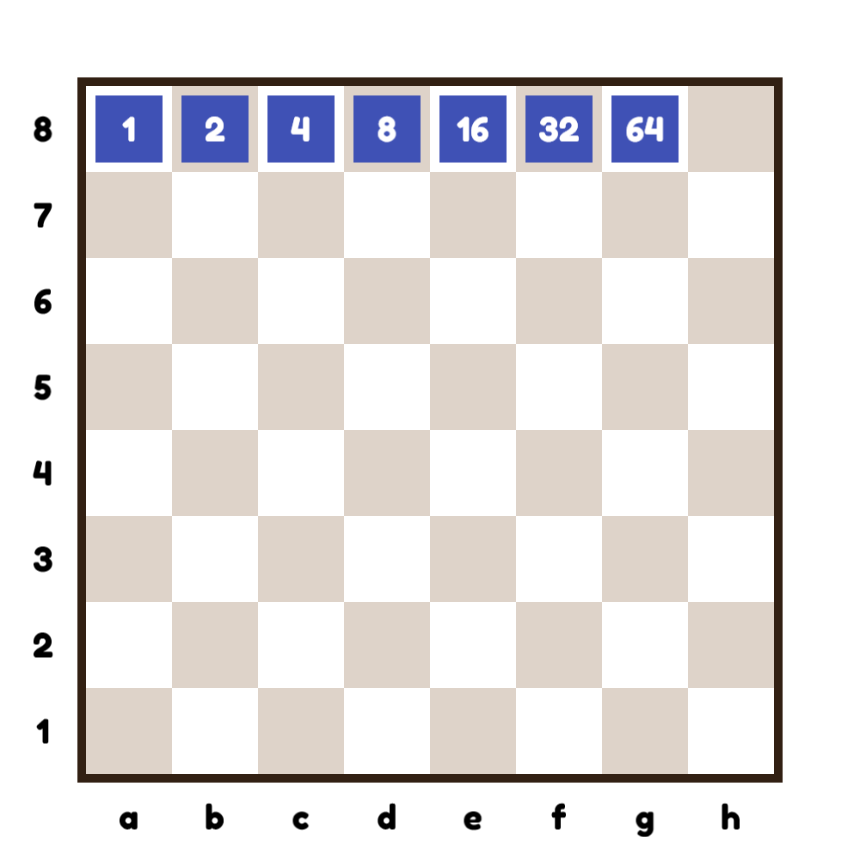
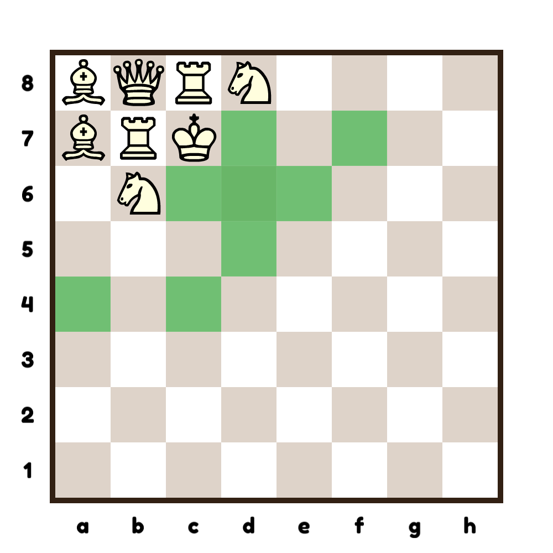
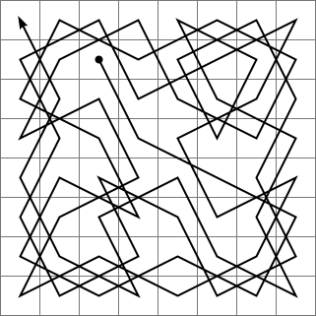
Resources for developing numeracy
-value and movement of the pieces
-properties of the board
Copyright © LearningChess 2019

Slide 10
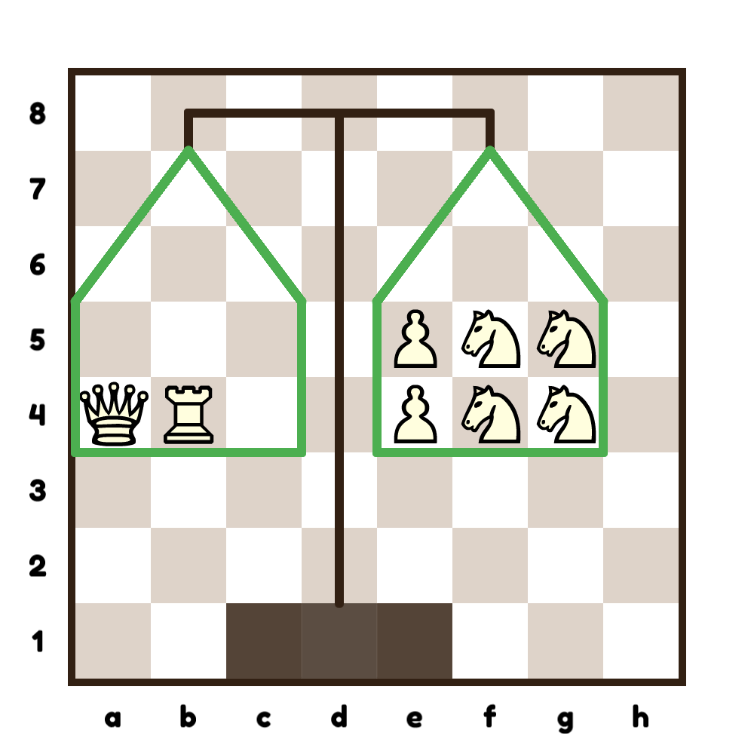
Using the value of the pieces
Copyright © LearningChess 2019

Slide 11
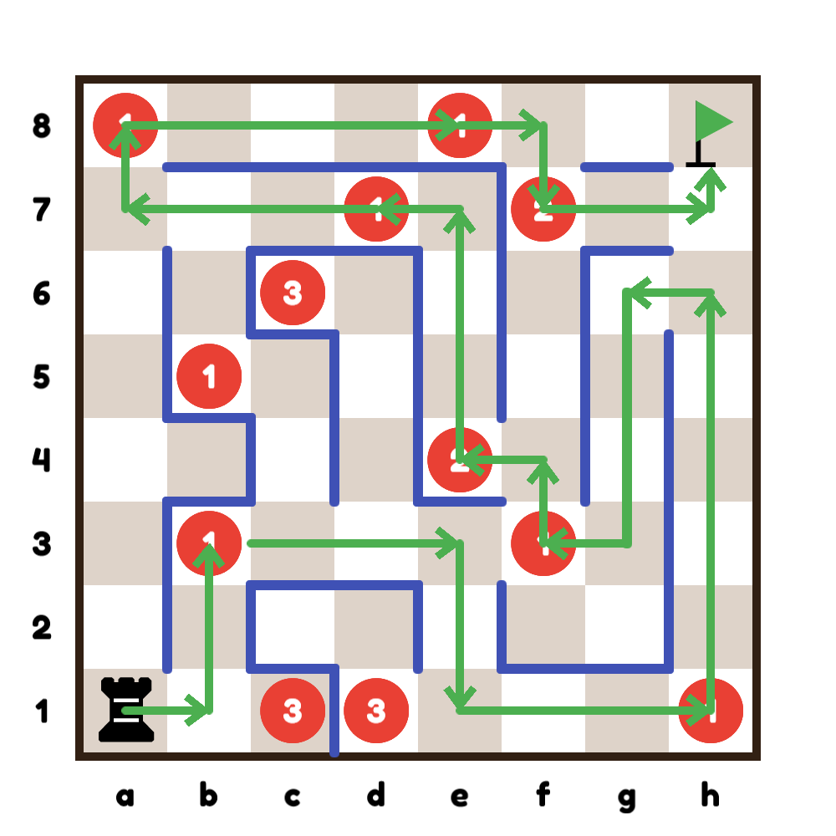
Addition
1 + 1 + 1 + 2 + 1 + 1 + 1 + 2 = 10
Copyright © LearningChess 2019

Slide 12
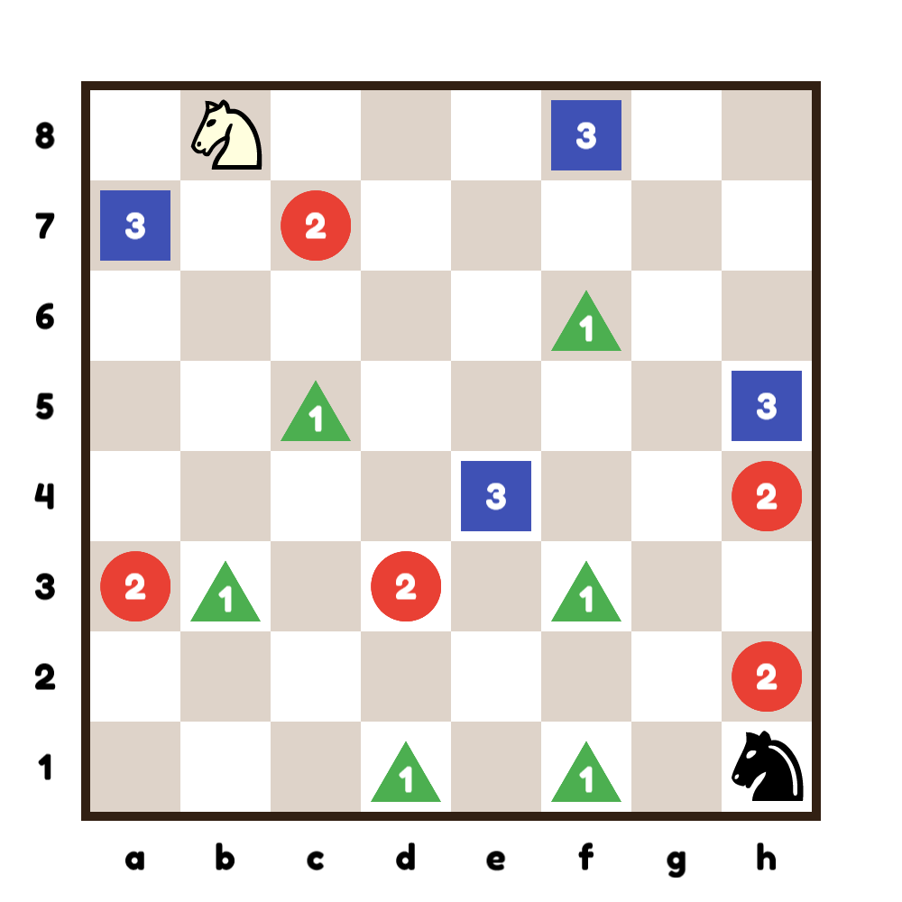
Addition
Copyright © LearningChess 2019

Slide 13
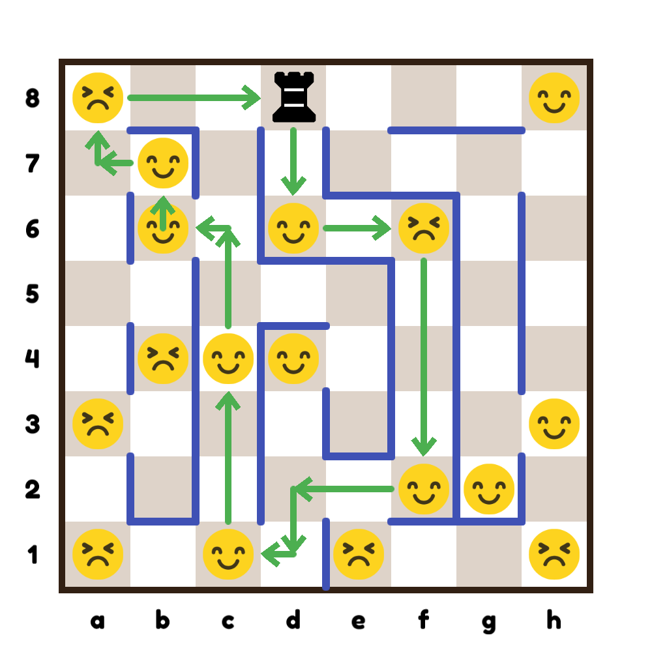
Negative numbers and subtraction
6😊 + 2😣 = 4😊
Copyright © LearningChess 2019

Slide 14
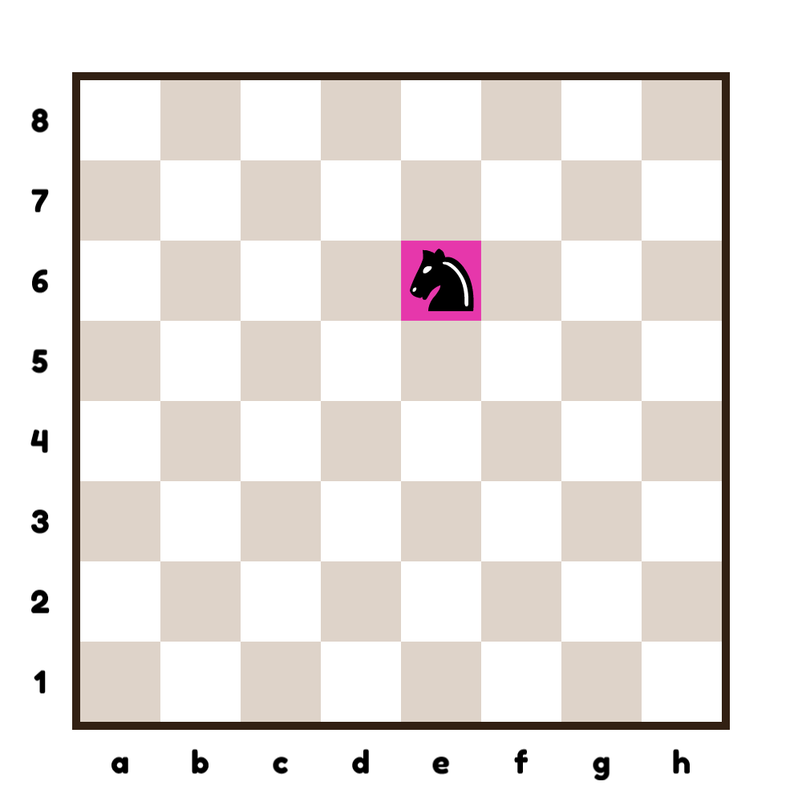
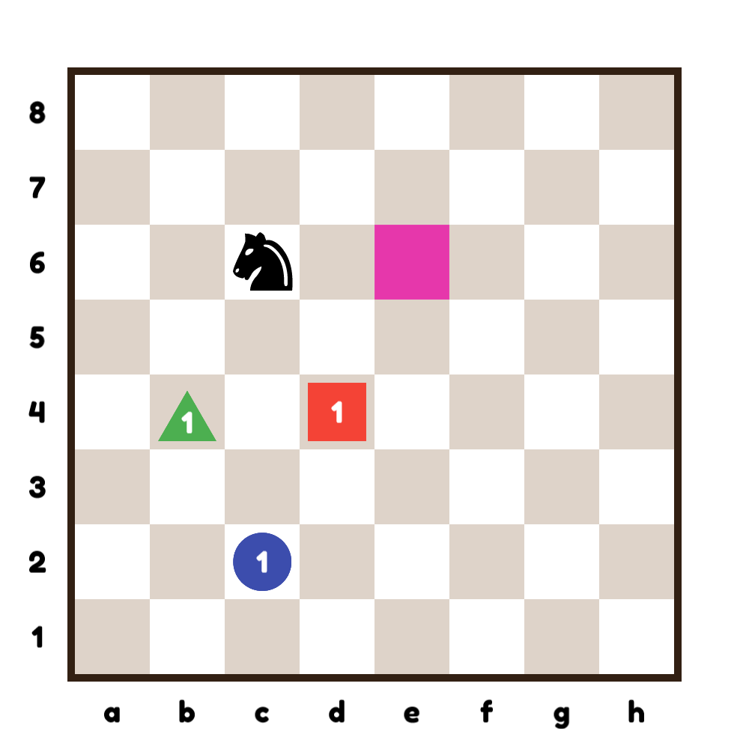
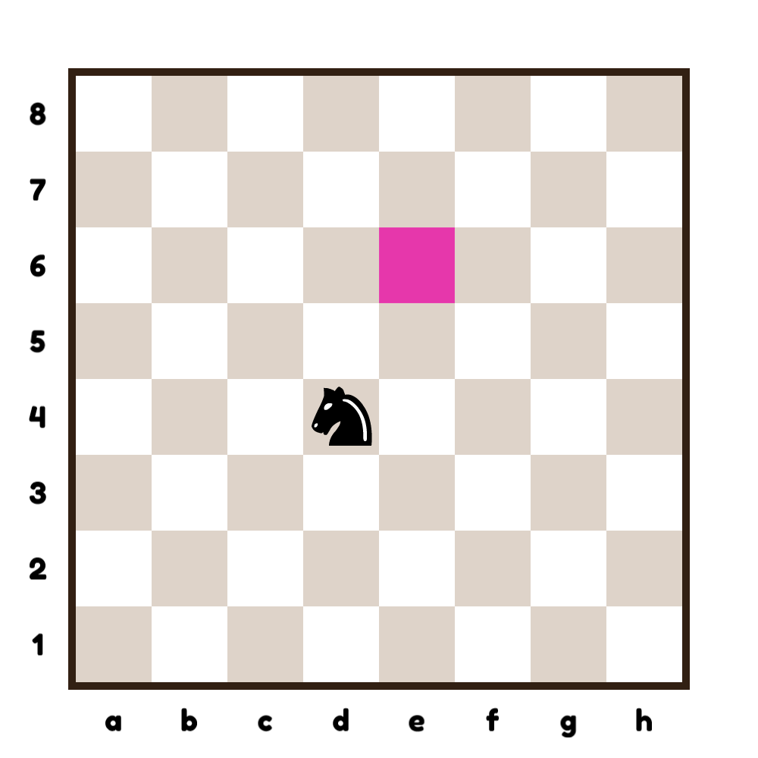
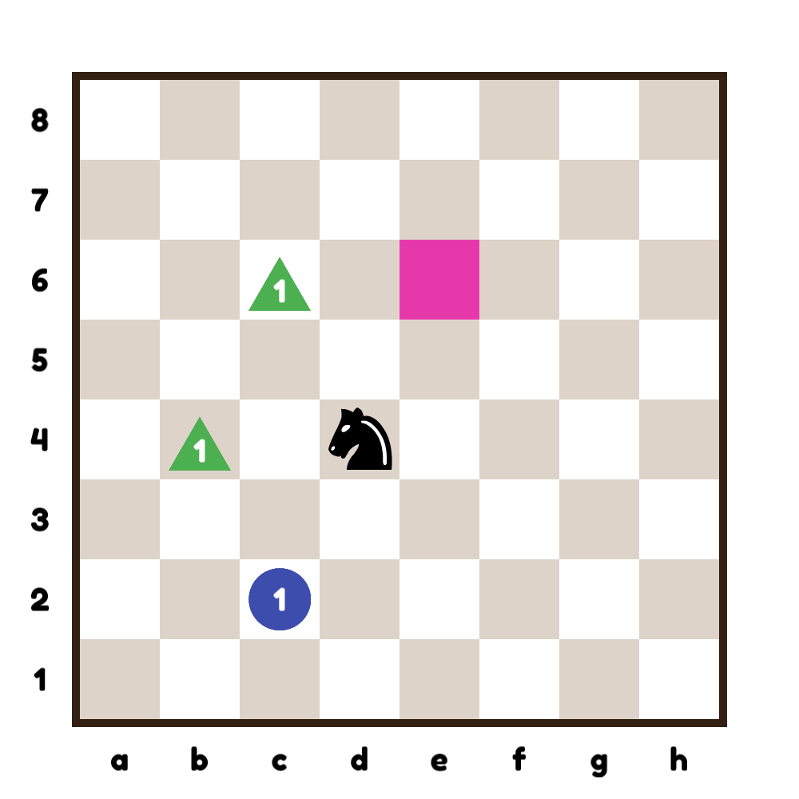
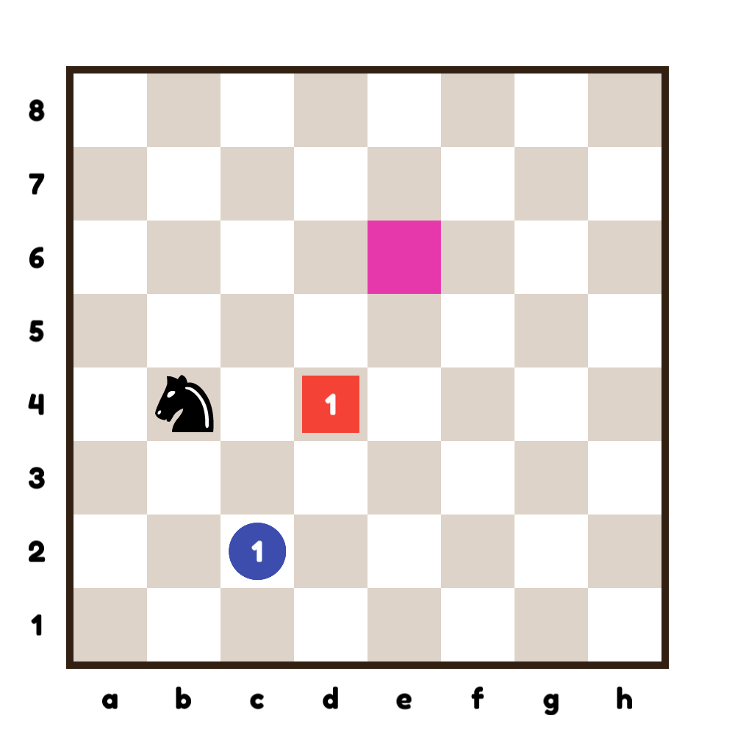
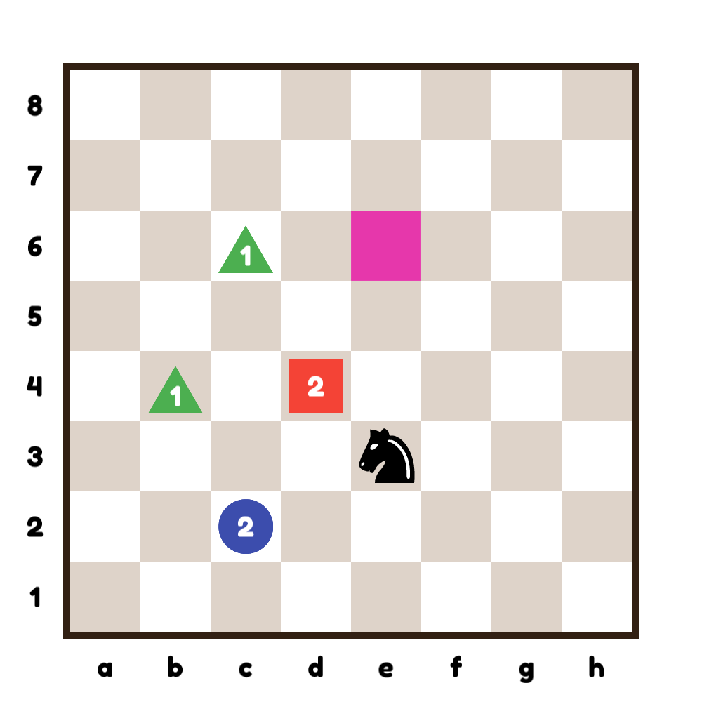
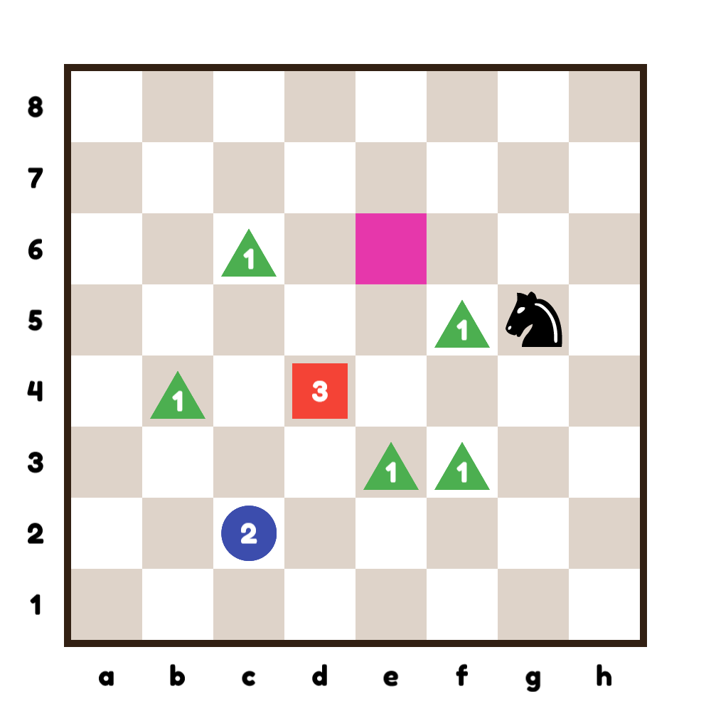
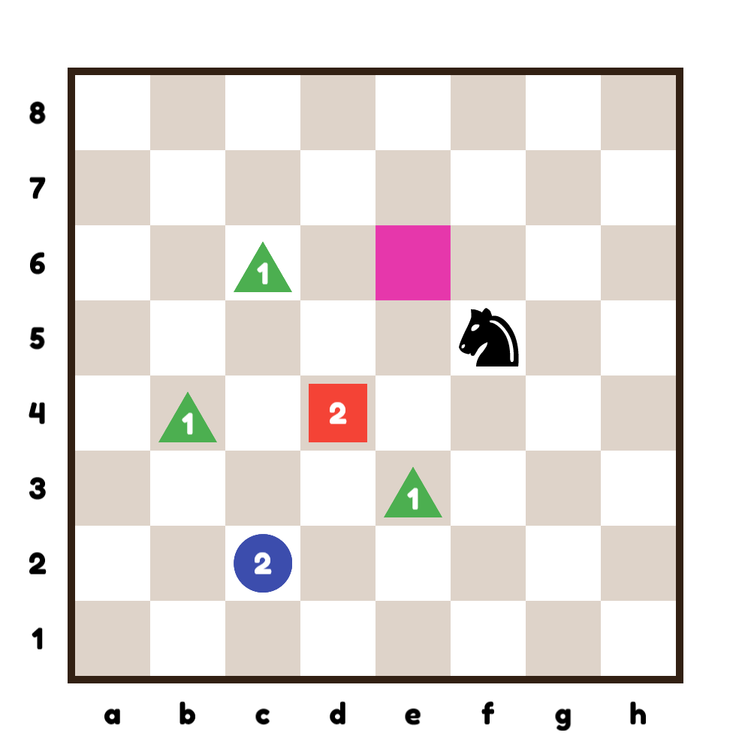
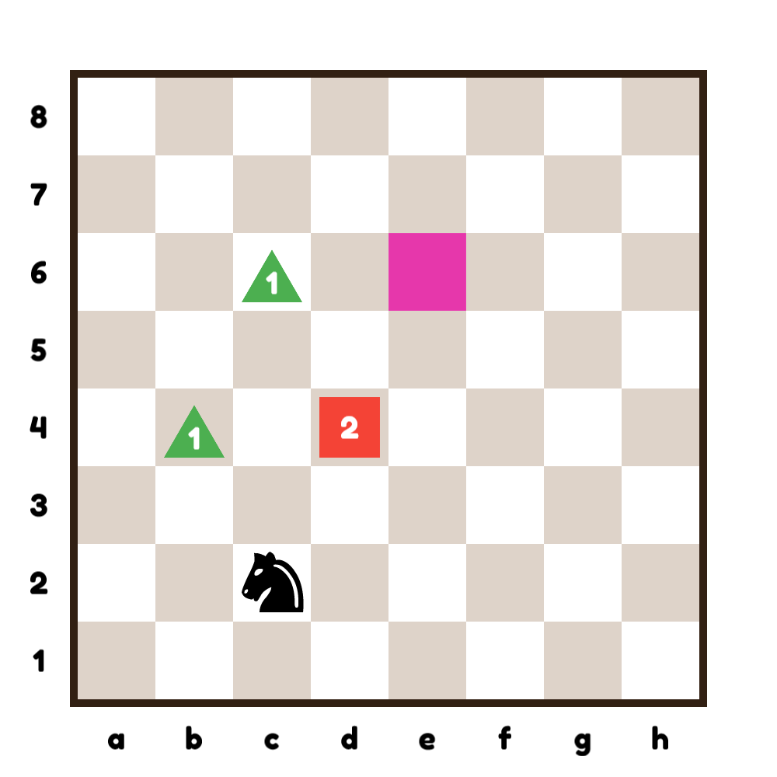
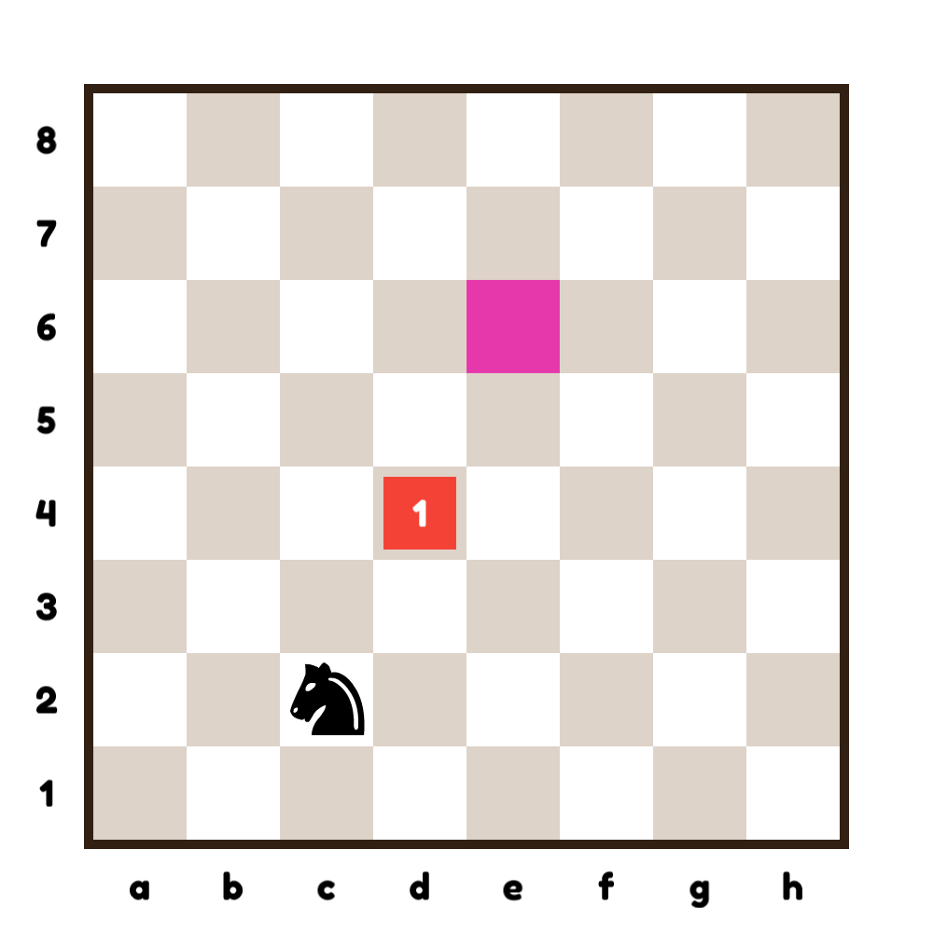
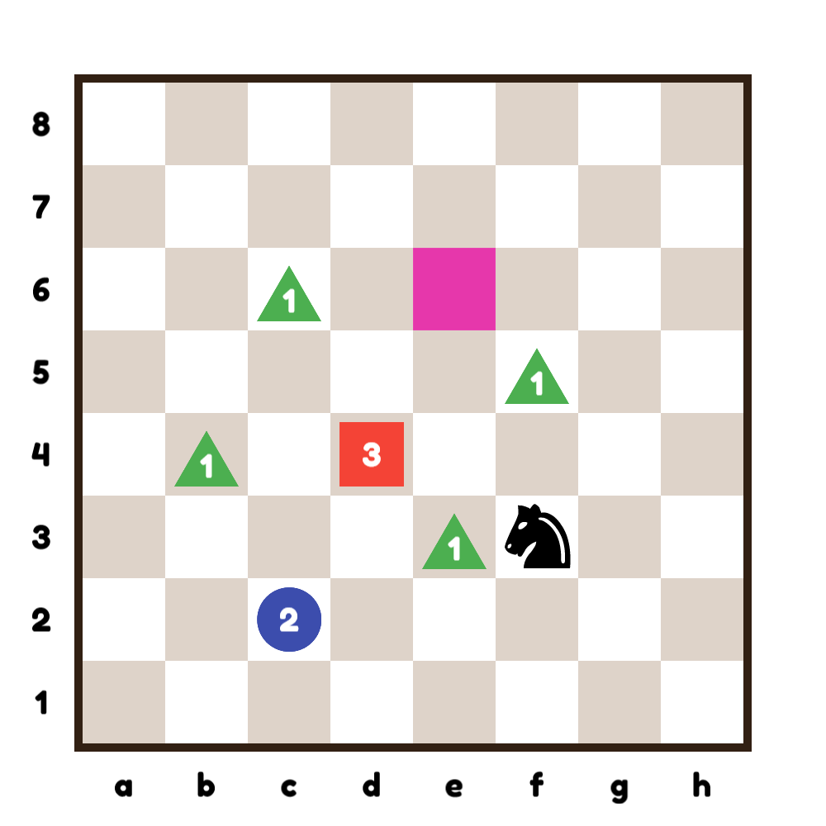
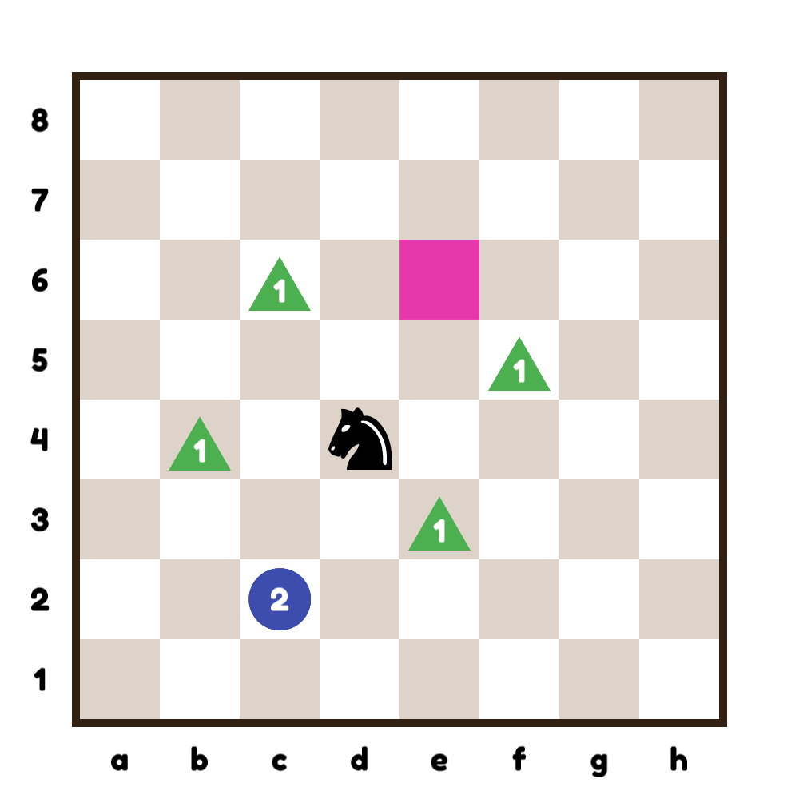
Combining themes
Copyright © LearningChess 2019

Slide 15
Relations:
Note:
the king is invaluable, and can’t be measured in pawns like other pieces.
Copyright © LearningChess 2019

Slide 16
Relations
Copyright © LearningChess 2019

Slide 17
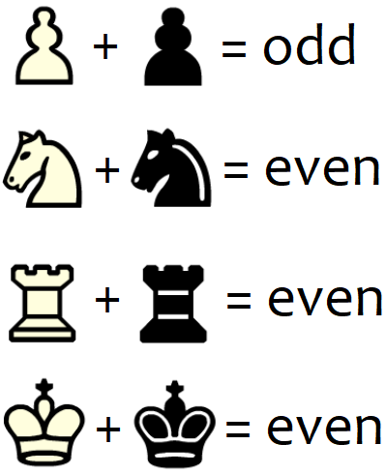
Parity
It’s white who made the last move, so black wins with Nxc2#!
Copyright © LearningChess 2019

Slide 18
How many different ways are possible in 4 moves?
Copyright © LearningChess 2019

Slide 19
All diagrams were made with LogiQ Board.
Examples (slides 3-16) were taken from the collection ‘Board Buddies in LogiQ Land’, which will be published soon.
Mark Szavin
education@learningchess.net
szavinm@yahoo.com
+36 30 556 5965
Copyright © LearningChess 2019

